Slide 1
The future of Python dependencies management is here!

Slide 2
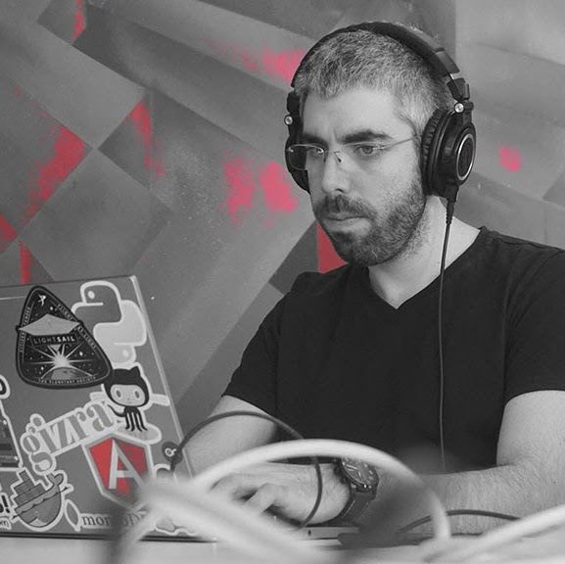
{
“name”: “Nir Galon”,
“twitter”: “@nirgn975”,
“github”: “github.com/nirgn975”
“website”: “www.nirgn.com”
}

Slide 3

Pip is great!

Slide 4
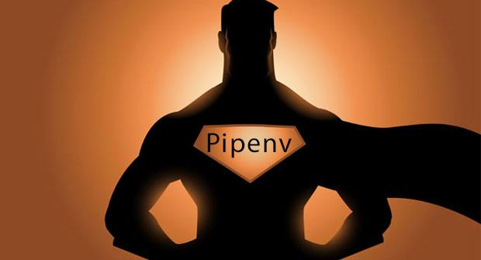
But not compares to the superpowers npm offers (or yarn) (or composer) (or bundler) (or … really?!)

Slide 5

But why should I use it ?
Kenneth Reitz - Everything * for Humans author

Slide 6
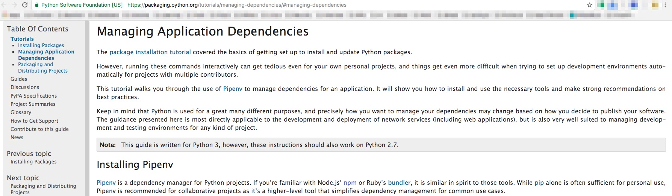
But why should I use it ?
The officially recommended Python packaging tool

Slide 7
But why should I use it ?
It combines all the best practices
pip, Pipfile, virtualenv

Slide 8

But why should I use it ?
It’ll give you superpowers !!!

Slide 9
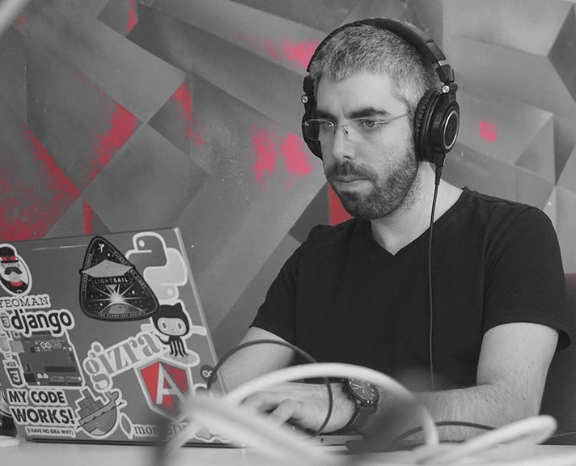
Thanks!
Contact me:
Nir Galon
Email: nir@galon.io
Website: http://nirgn.com
Twitter: @nirgn975
GitHub: nirgn975

